Slide 1
150, 148 & 140 S. MAIN

Slide 2
MAY 28, 2016 FIRE DESTROYED THE 3 STRUCTURES
7/13/16: LETTER SENT REQUESTING A TIME LINE FOR CLEAN UP
7/25/16: MET WITH MR. WALLACE; HE STATED HE WAS STILL WORKING WITH INSURANCE COMPANIES
7/25/16: MR. WALLACE WAS TOLD I WOULD NEED WEEKLY UPDATES
7/28/2016: MET WITH MR. WALLACE; HE STATED HE HAD HIRED A PUBLIC ADJUSTER DUE TO DISPUTE OVER ITEMS IN BUILDING
OVER ITEMS IN THE BUILDING
8/2/16: LT. ALFORD SPOKE WITH CITY ATTORNEY; IT WAS DETERMINED A FIVE DAY LETTER
WOULD BE HAND DELIVERED

Slide 3
-8/3/16: 5 DAY LETTER DELIVERED ASKING MR. WALLACE TO PROVIDE DOCUMENTED
TIME LINE
-8/8/16: LETTER RECEIVED FROM MR. WALLACE VIA EMAIL STATING INSURANCE COMPANIES WERE
DONE AND CLEAN UP SHOULD START THE WEEK OF 8/15/16
-8/9/16 BOARD LETTER SENT TO MR. WALLACE, HAND CARRIED TO MR. WALLACE AND POSTED ON
ALL THREE STRUCTURES.

Slide 4
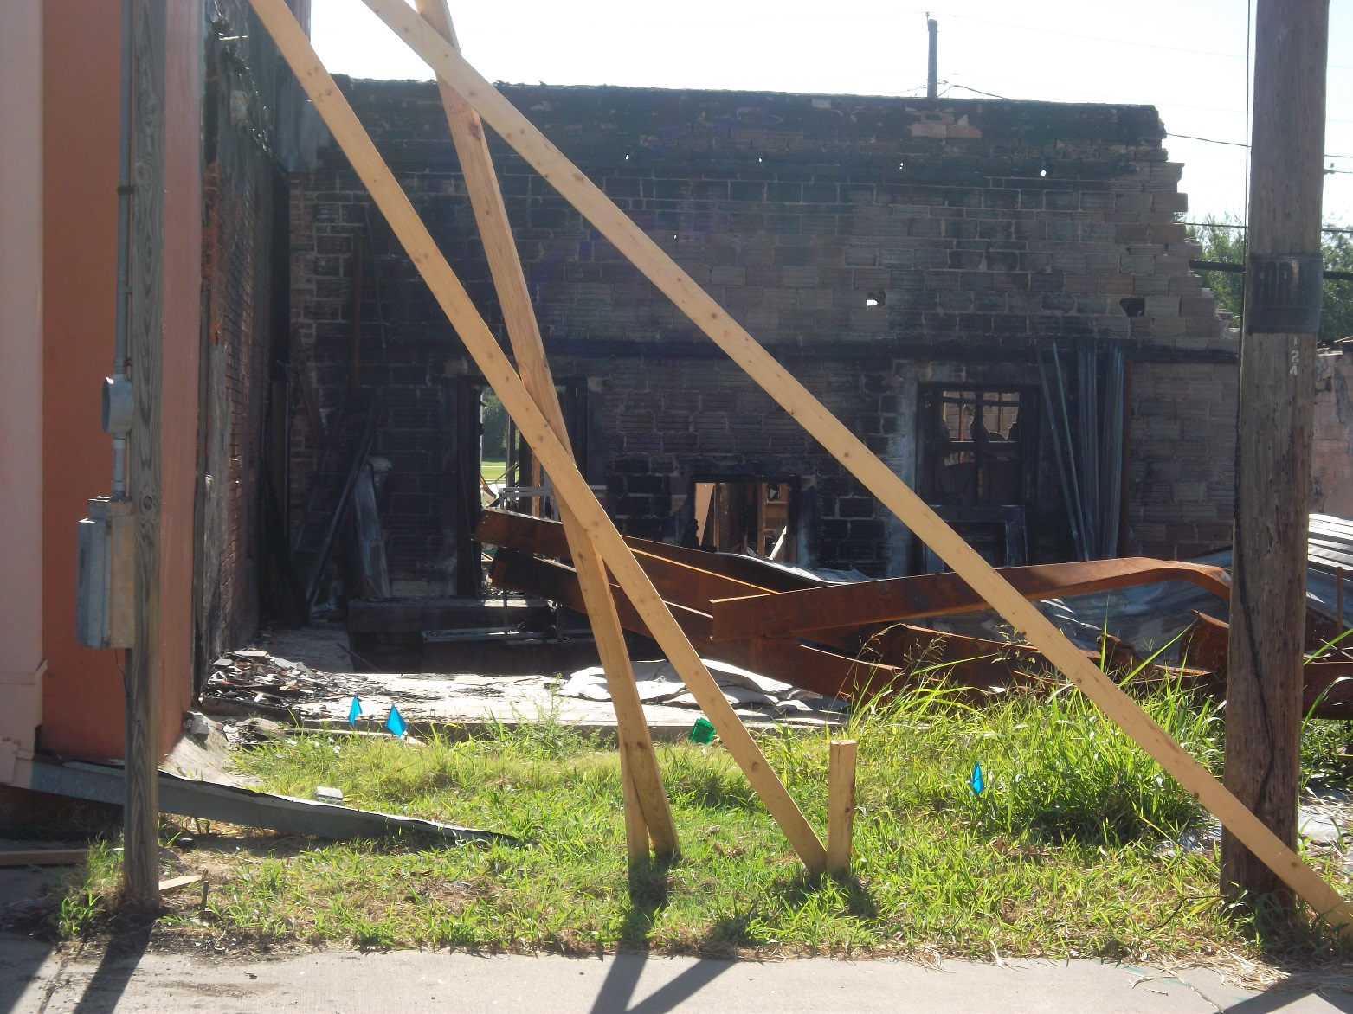
BACK SIDE OF BUILDING

Slide 5
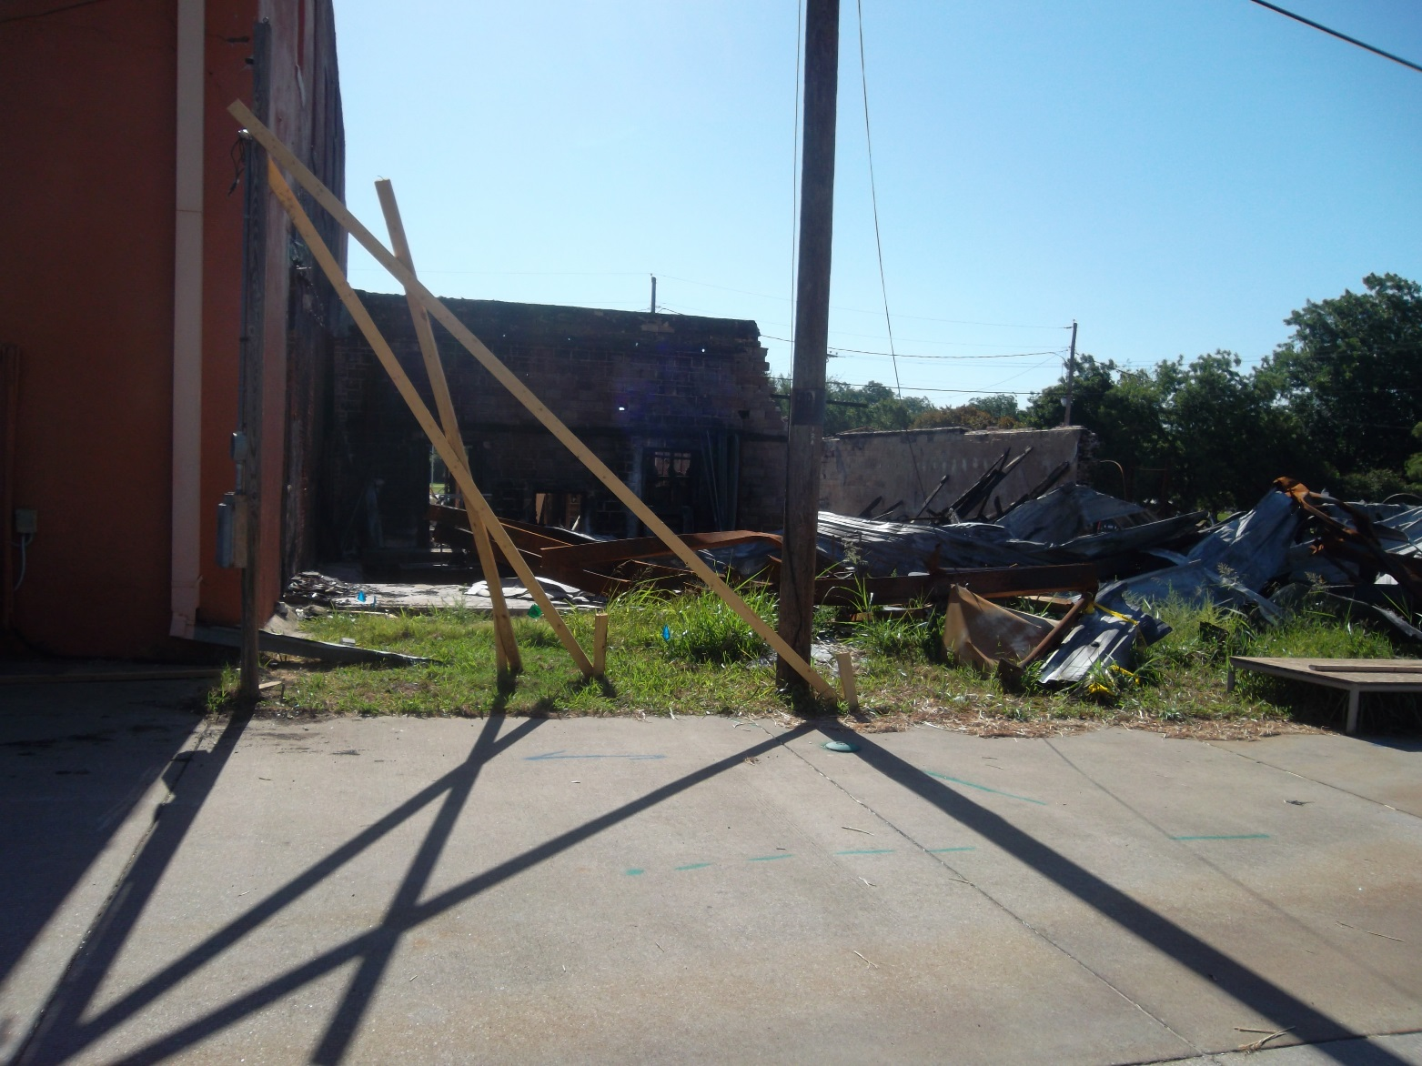
BACK SIDE OF BUILDING

Slide 6
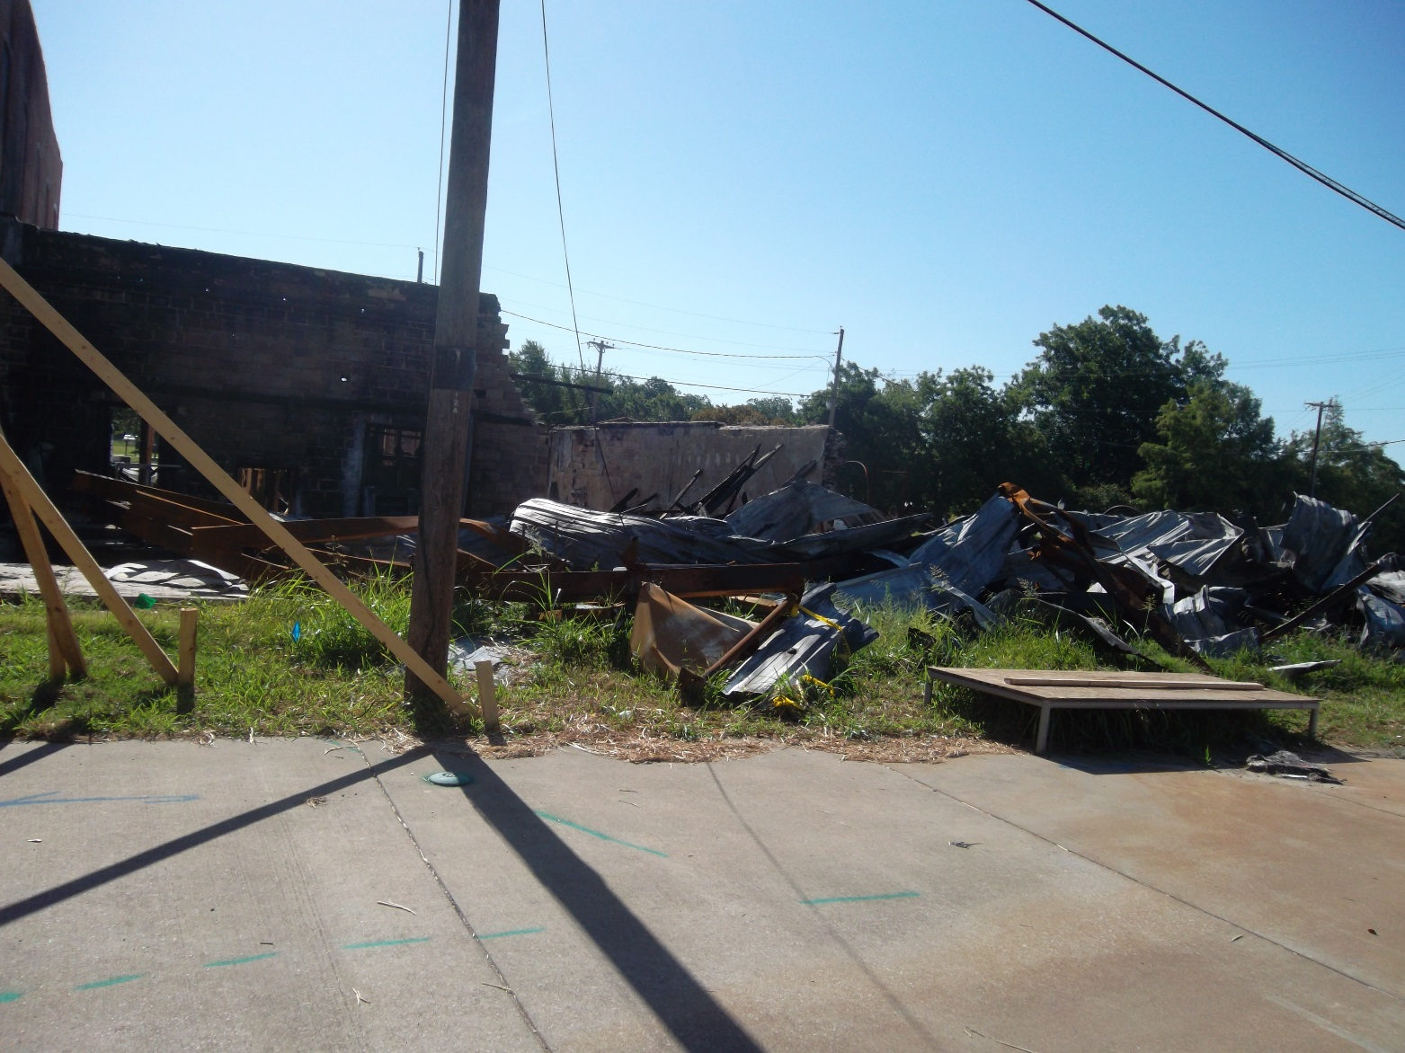
BACK SIDE OF BUILDING

Slide 7
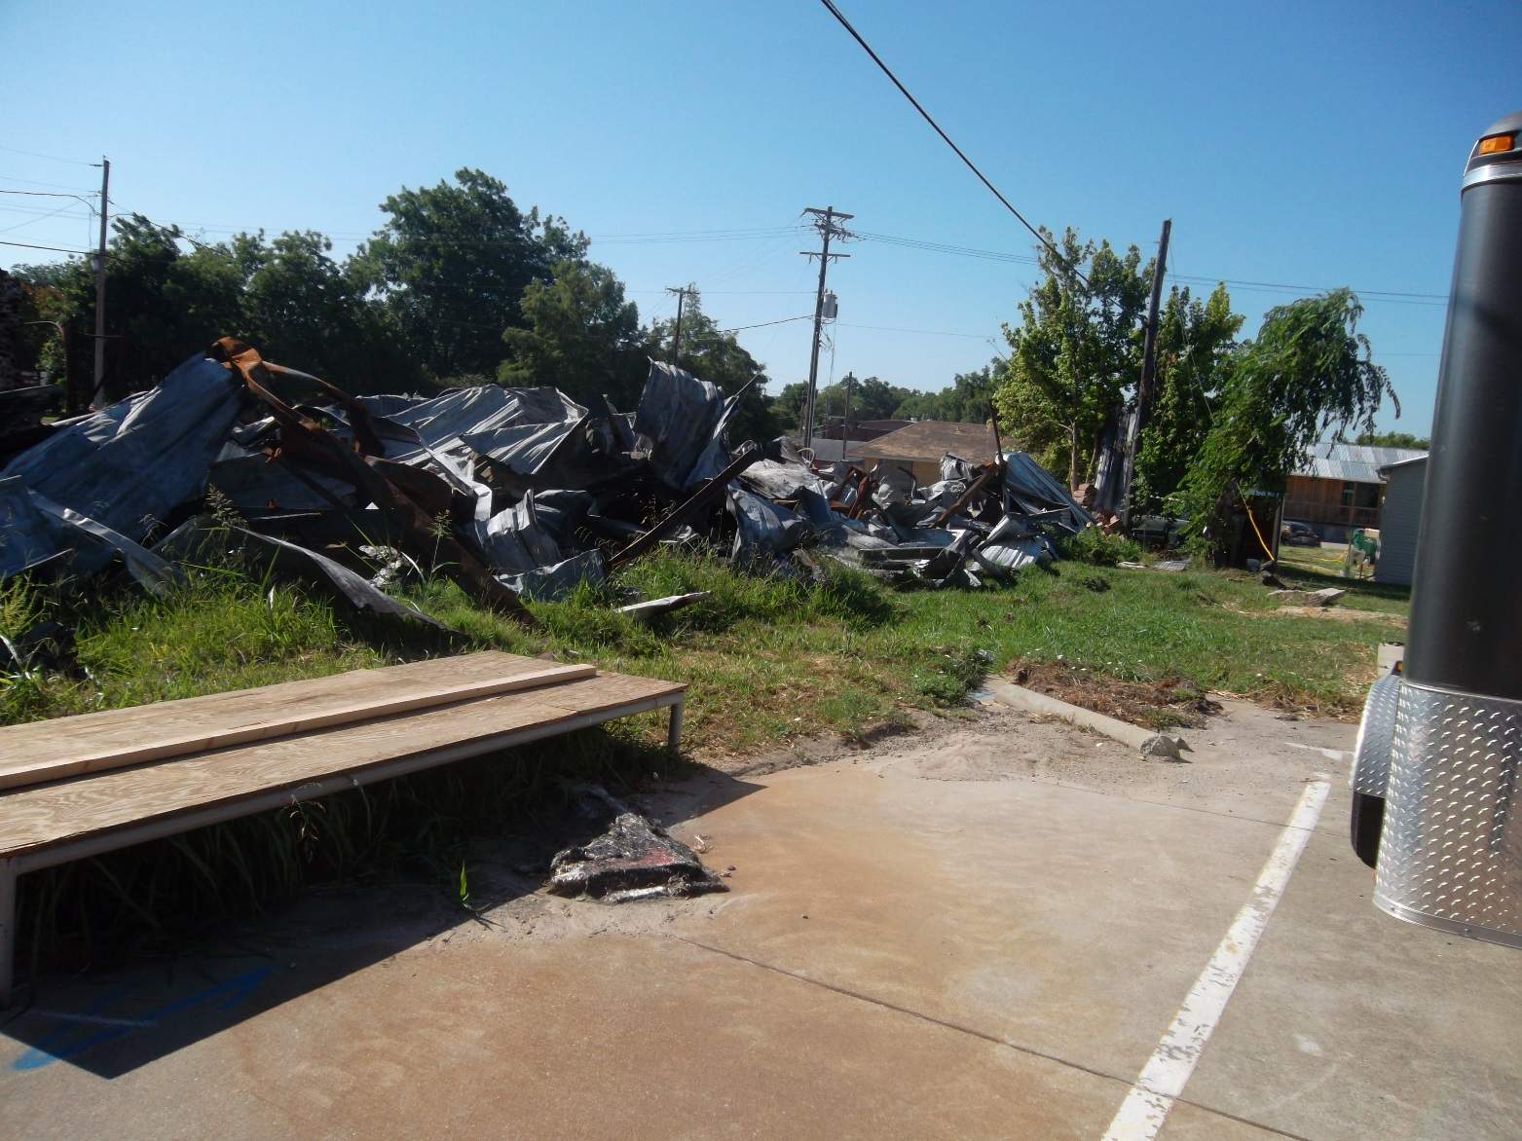
BACK SIDE OF BUILDING

Slide 8
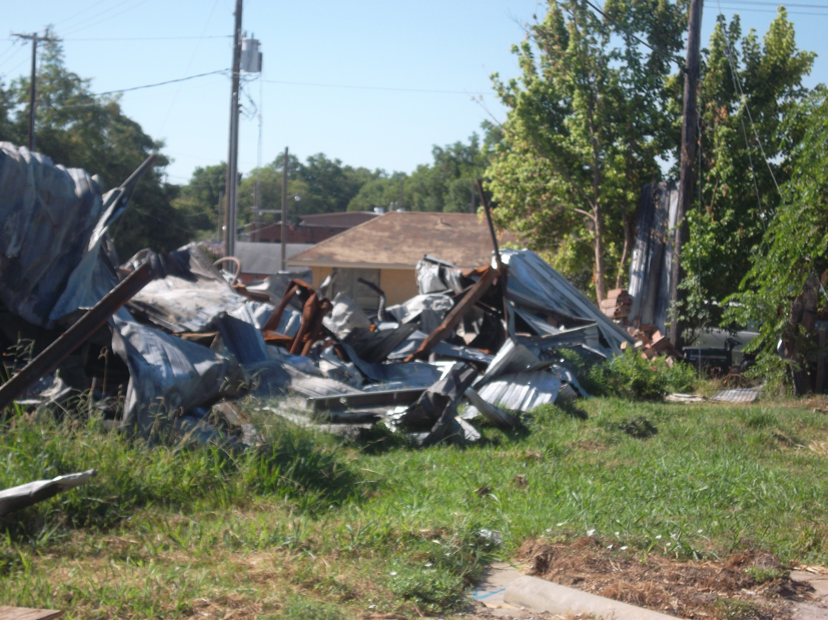
BACK SIDE OF BUILDING

Slide 9
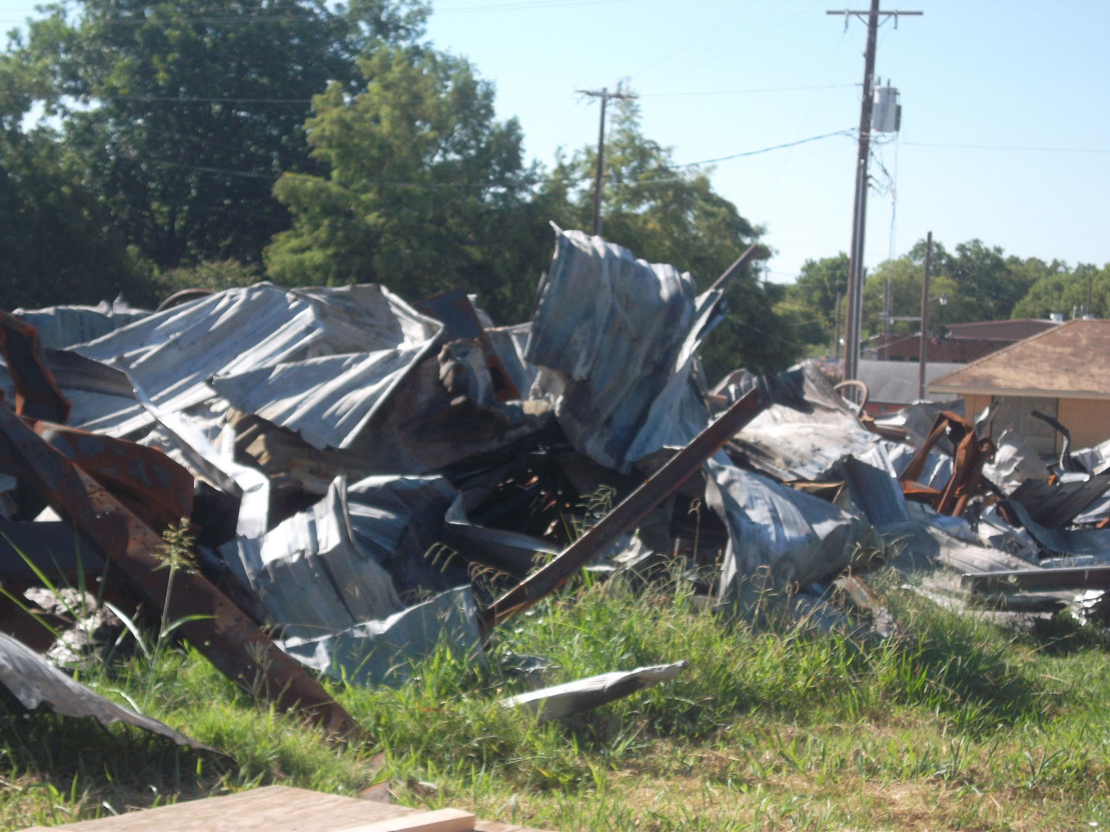
BAVK SIDE OF BUILDING

Slide 10
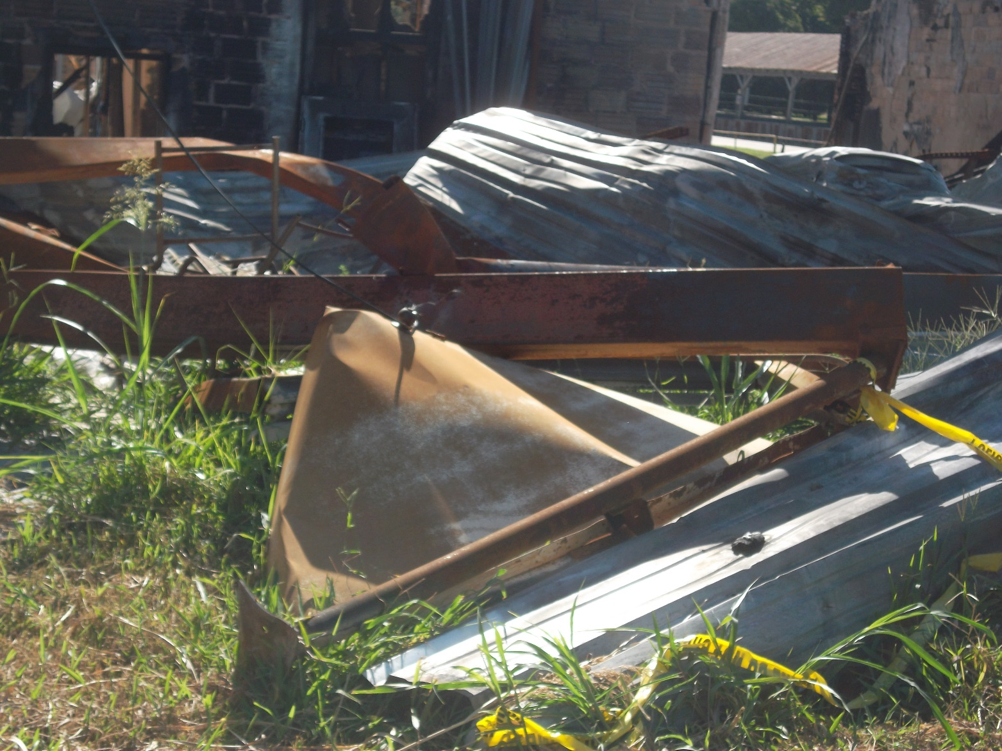
BACK SIDE OF BUILDING

Slide 11
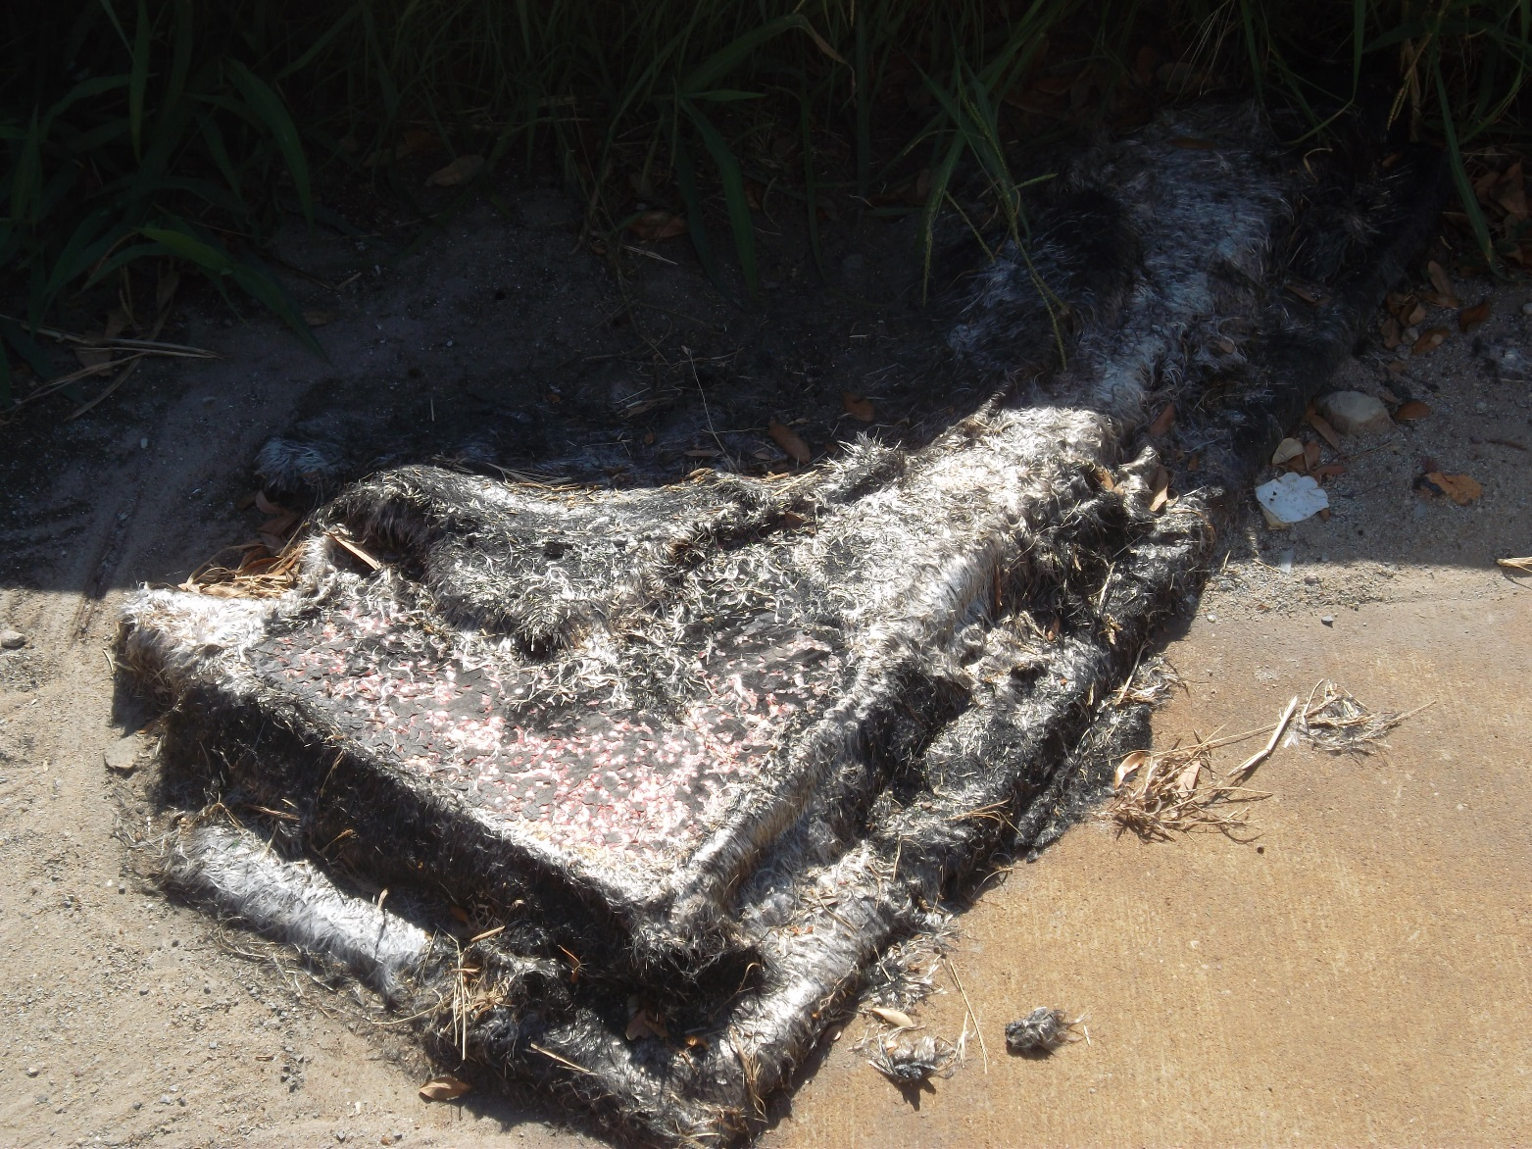
BACK SIDE OF BUILDING

Slide 12
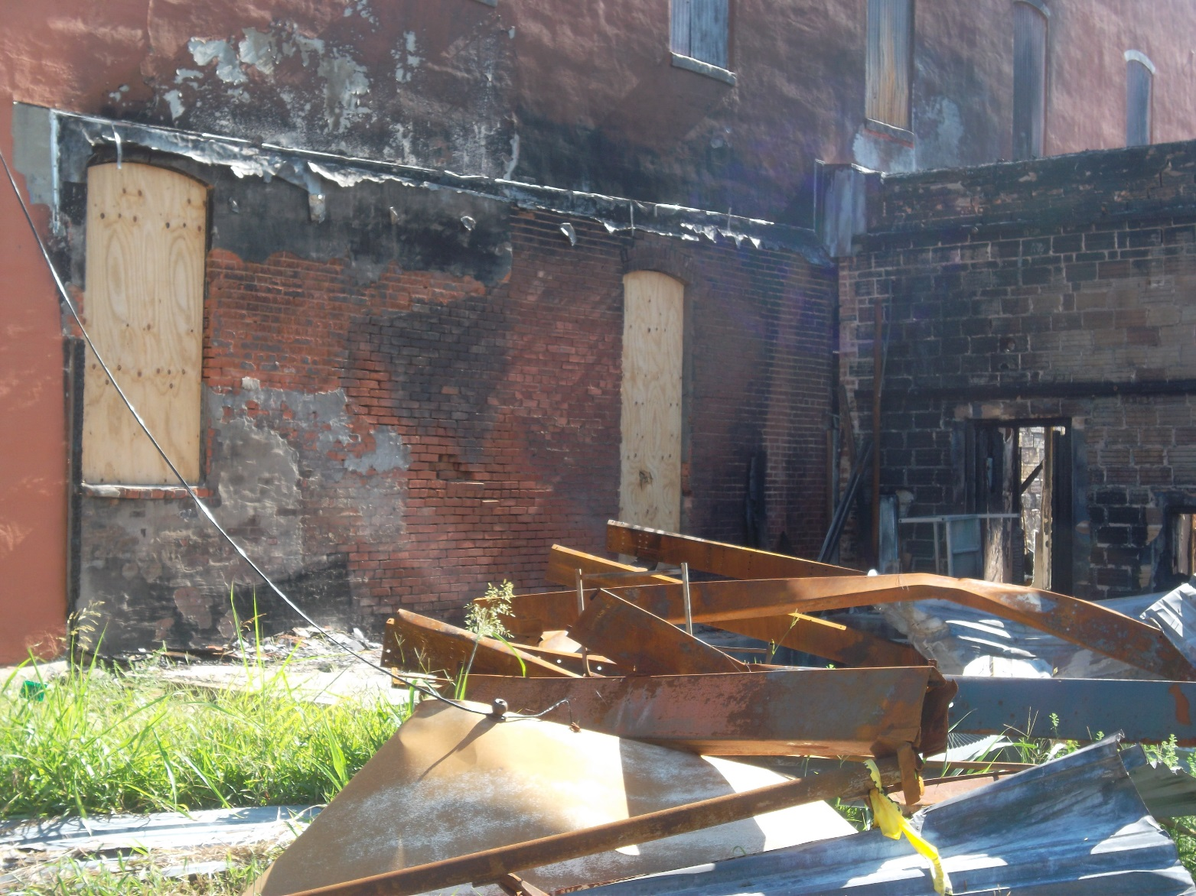
BACK SIDE OF BUILDING

Slide 13
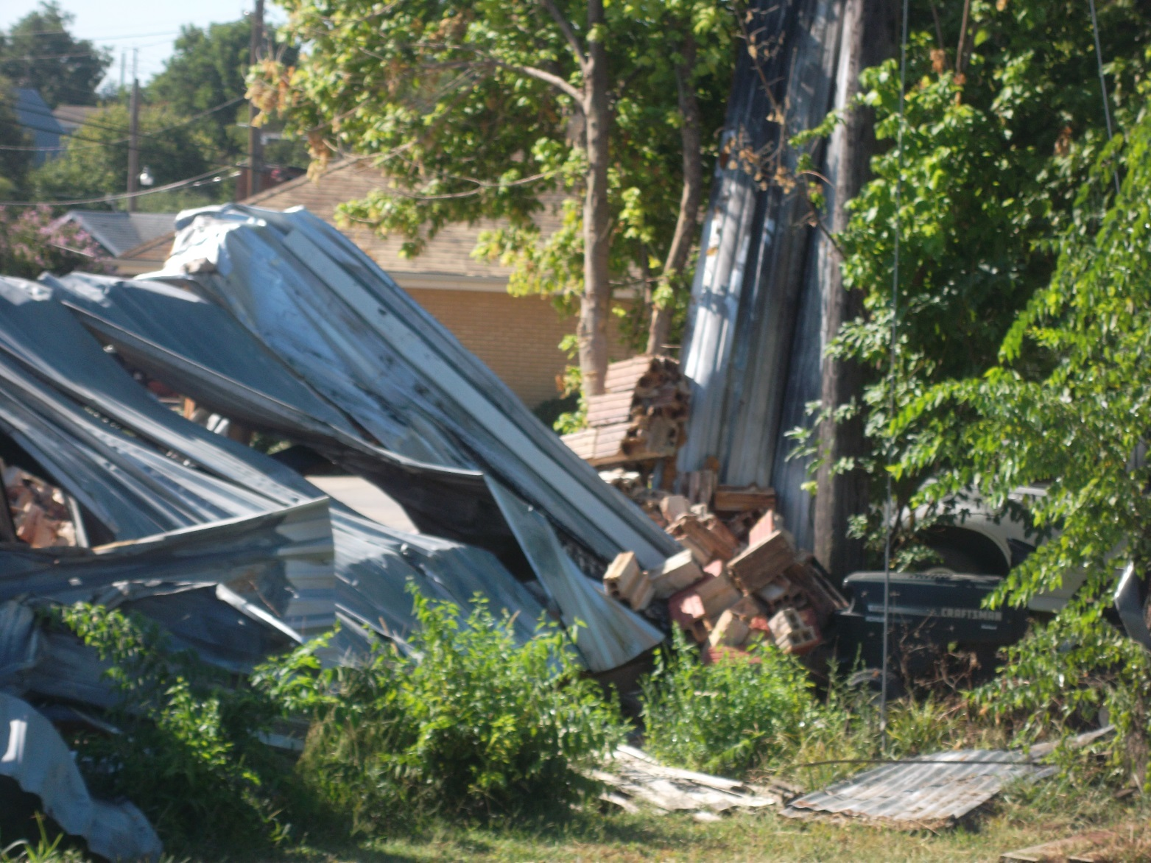
BACK SIDE OF BUILDING

Slide 14
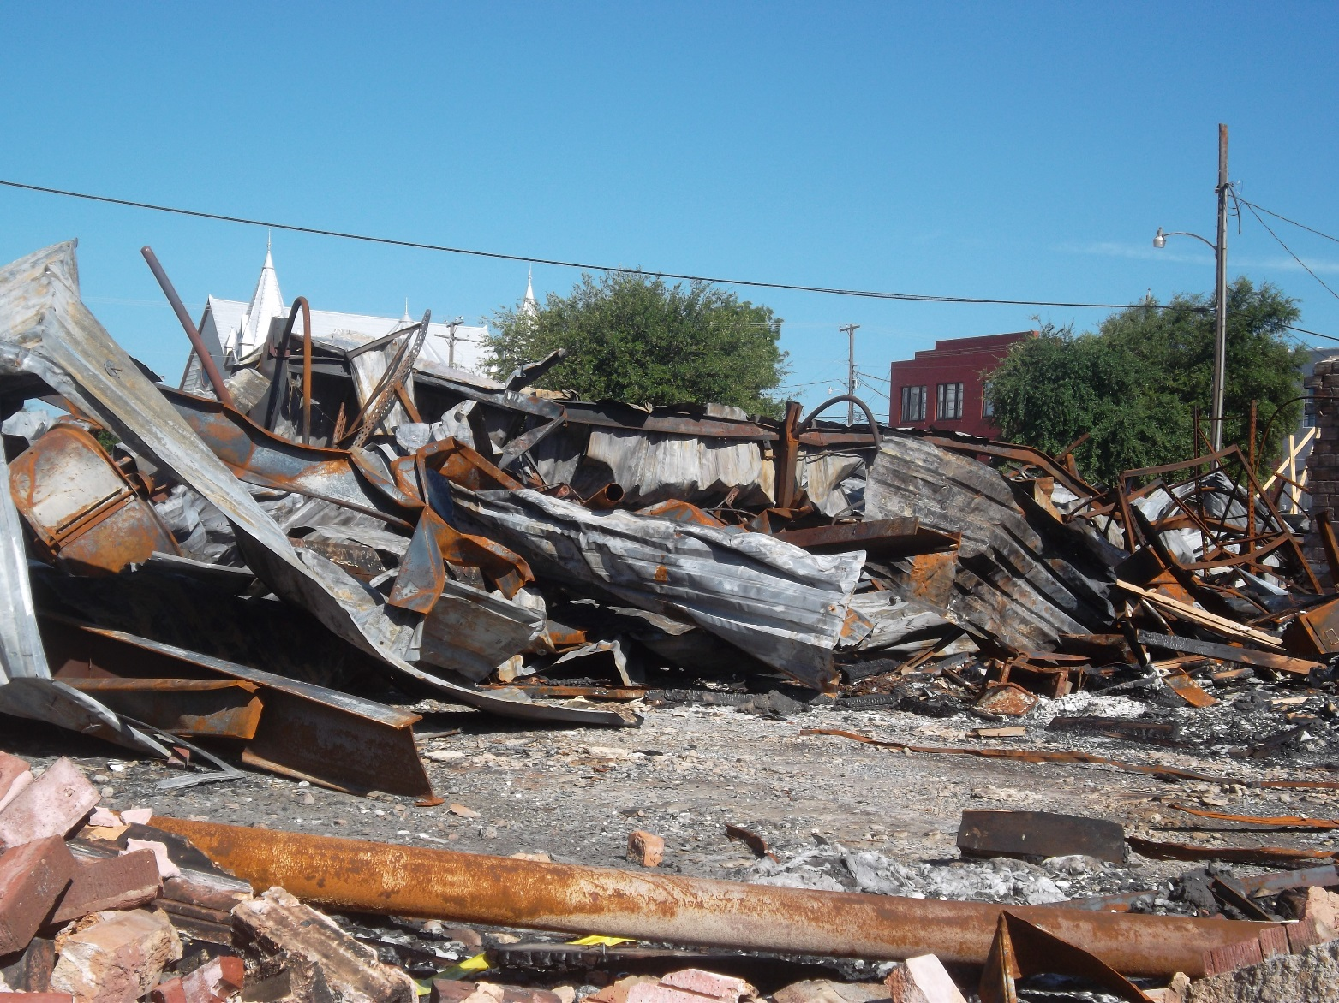
SIDE VIEW OF BUILDINGS

Slide 15
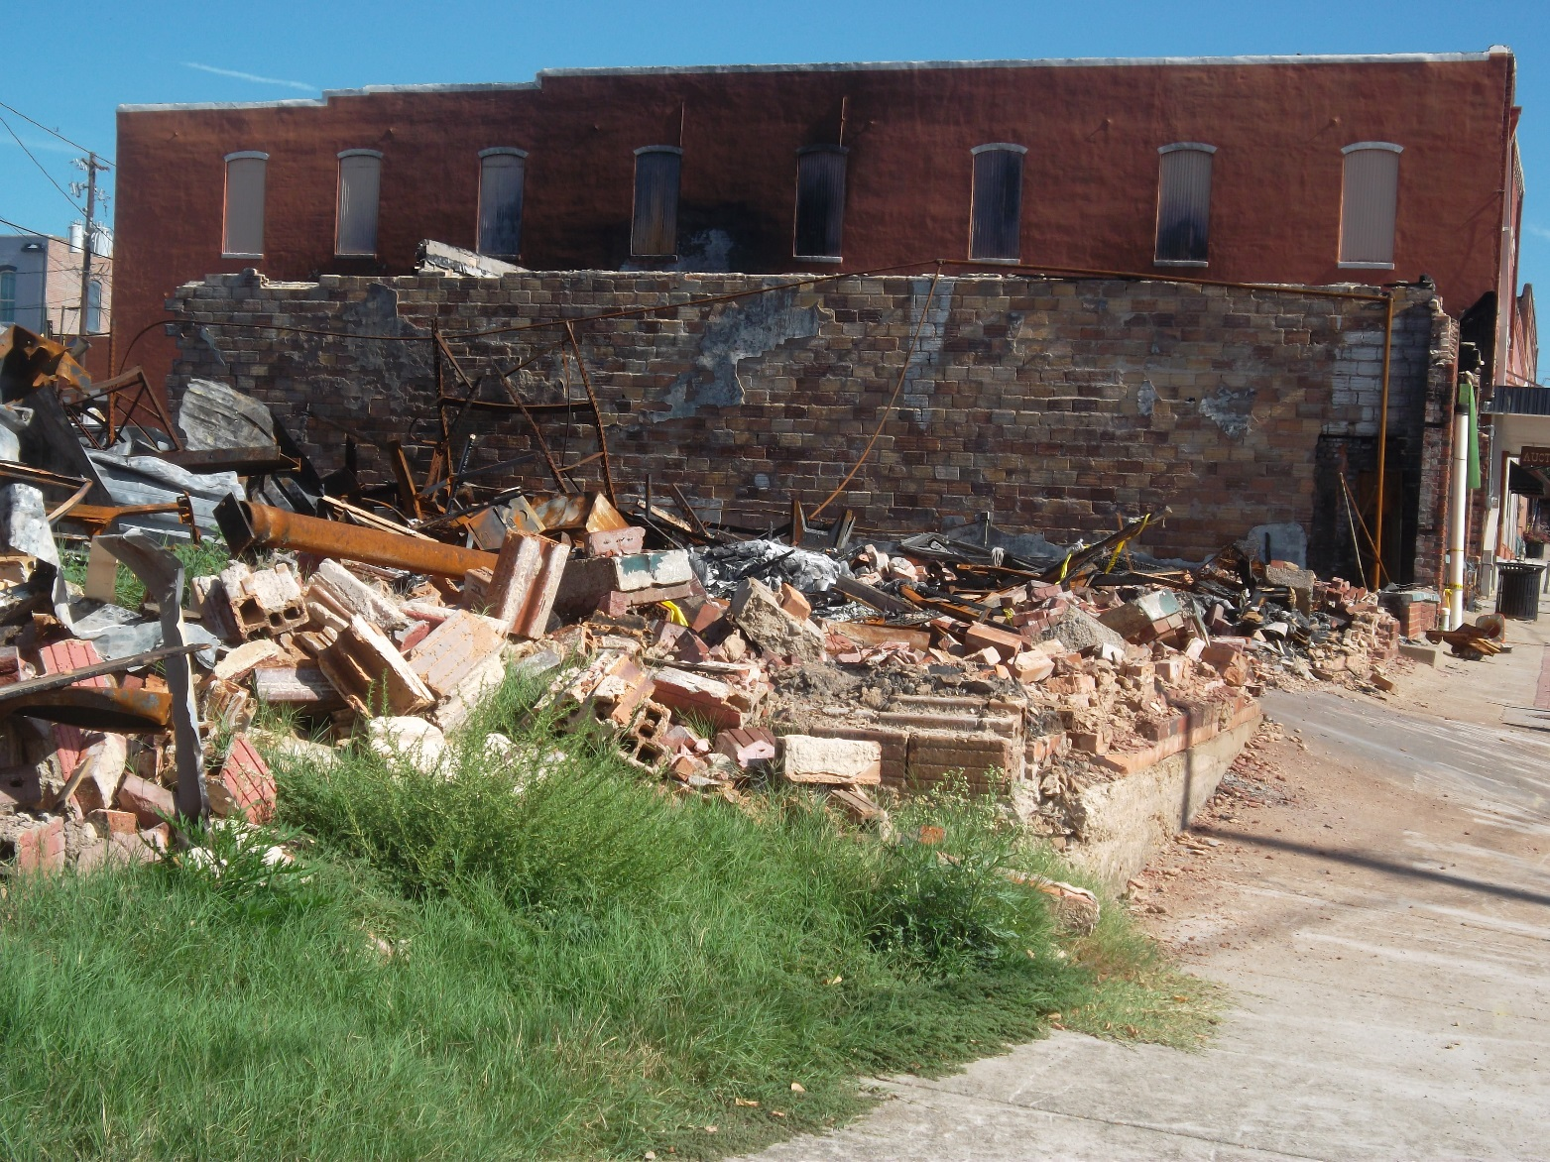
SIDE VIEW OF BUILDING

Slide 16
FRONT VIEW OF BUILDING

Slide 17
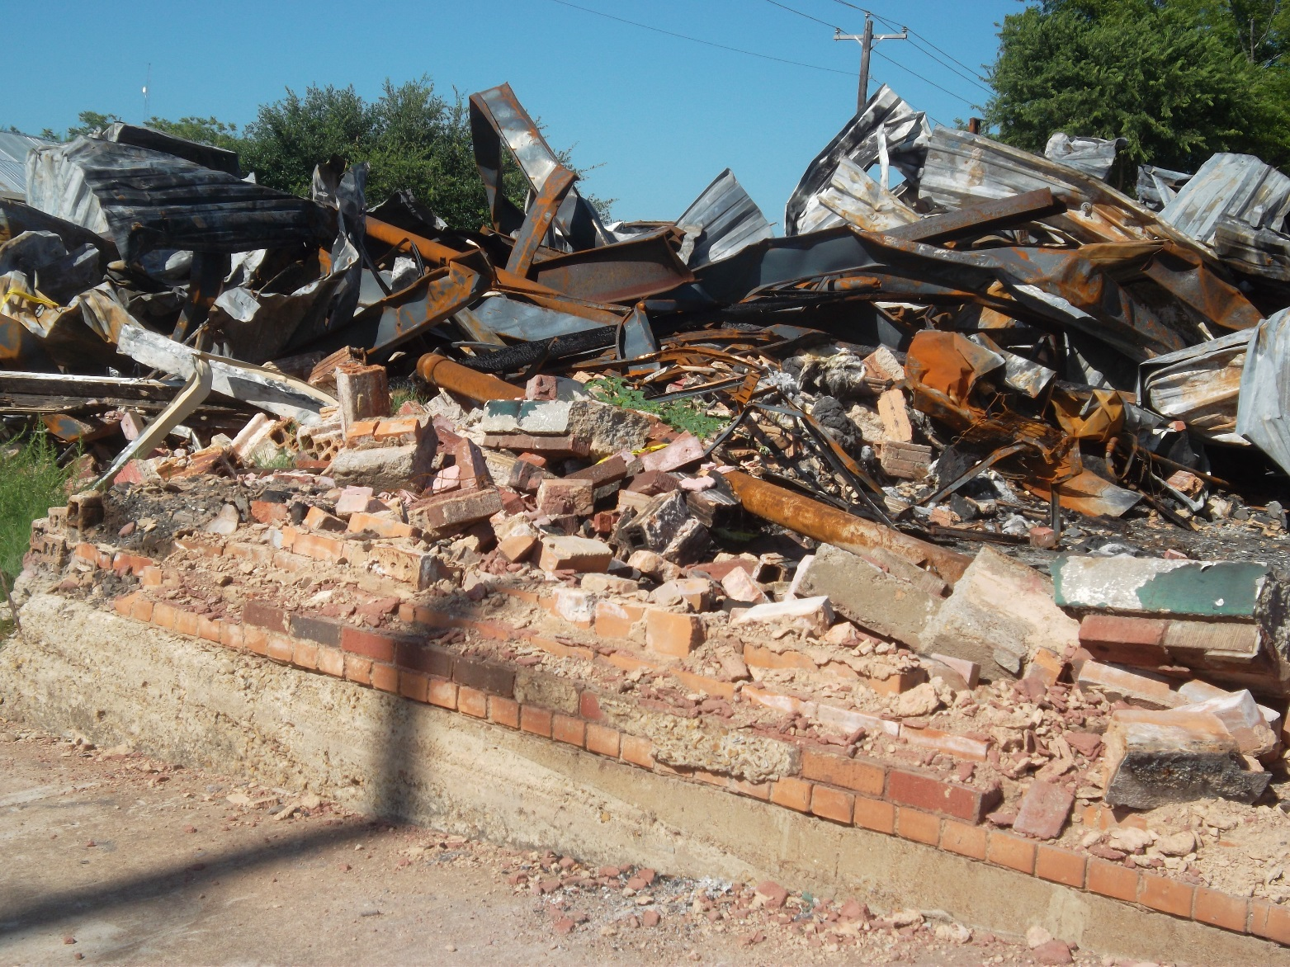
FRONT VIEW OF BUILDING

Slide 18
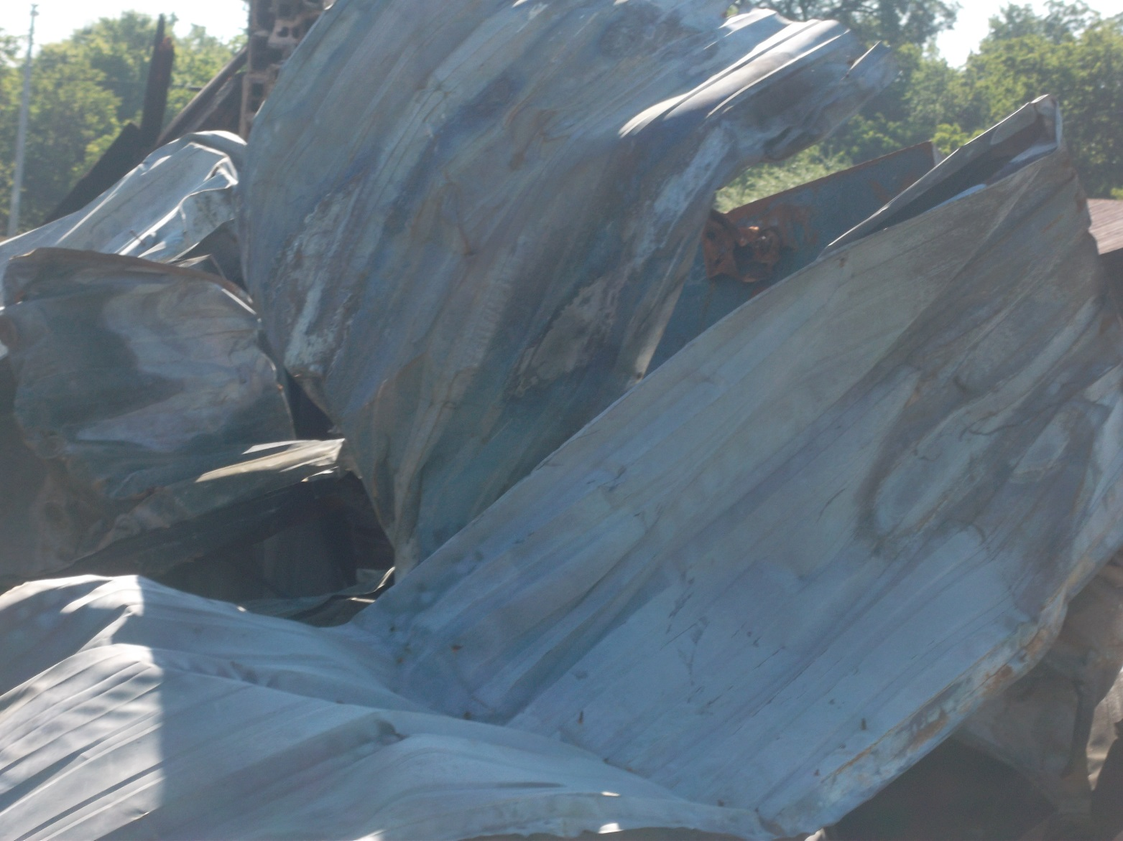
FRONT VIEW OF BUILDING

Slide 19
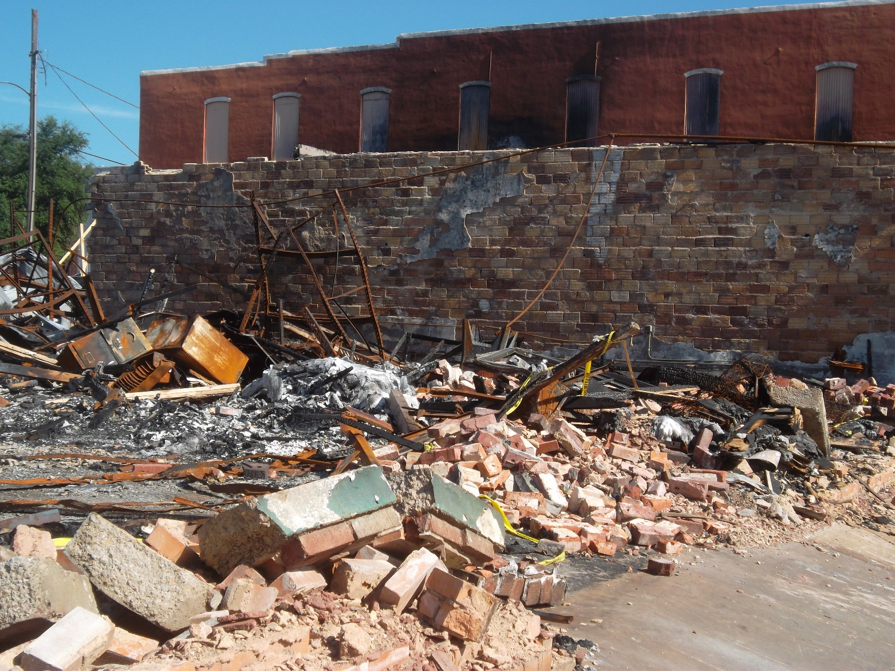
FRONT VIEW OF BUILDING

Slide 20
FRONT VIEW OF BUILDING

Slide 21
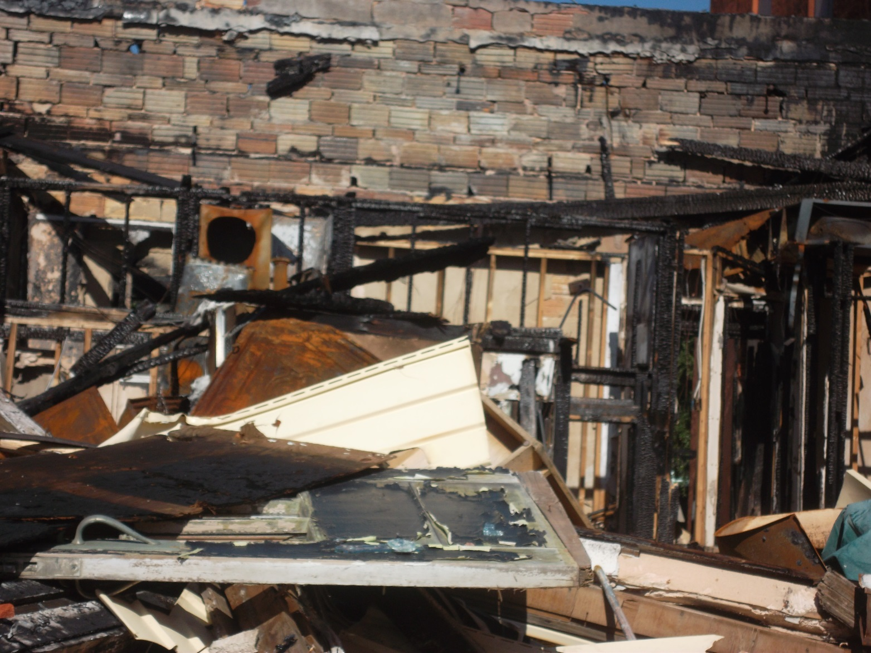
FRONT VIEW OF BUILDING

Slide 22
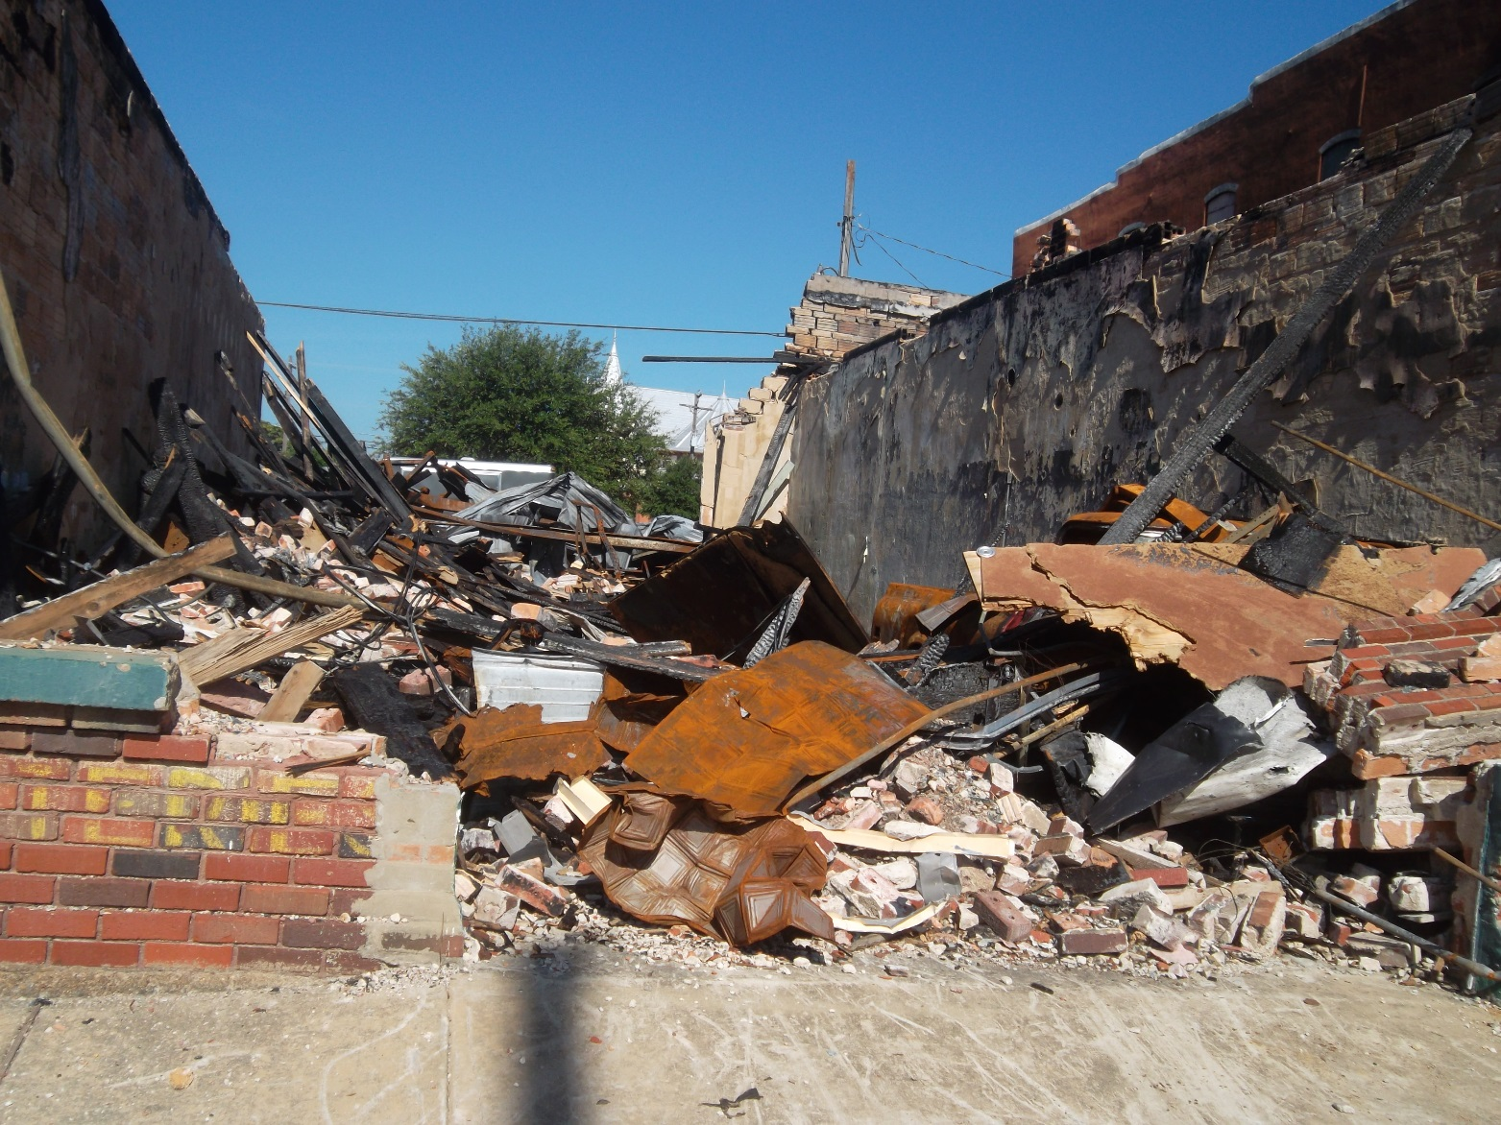
FRONT VIEW OF BUILDINGS

Slide 23
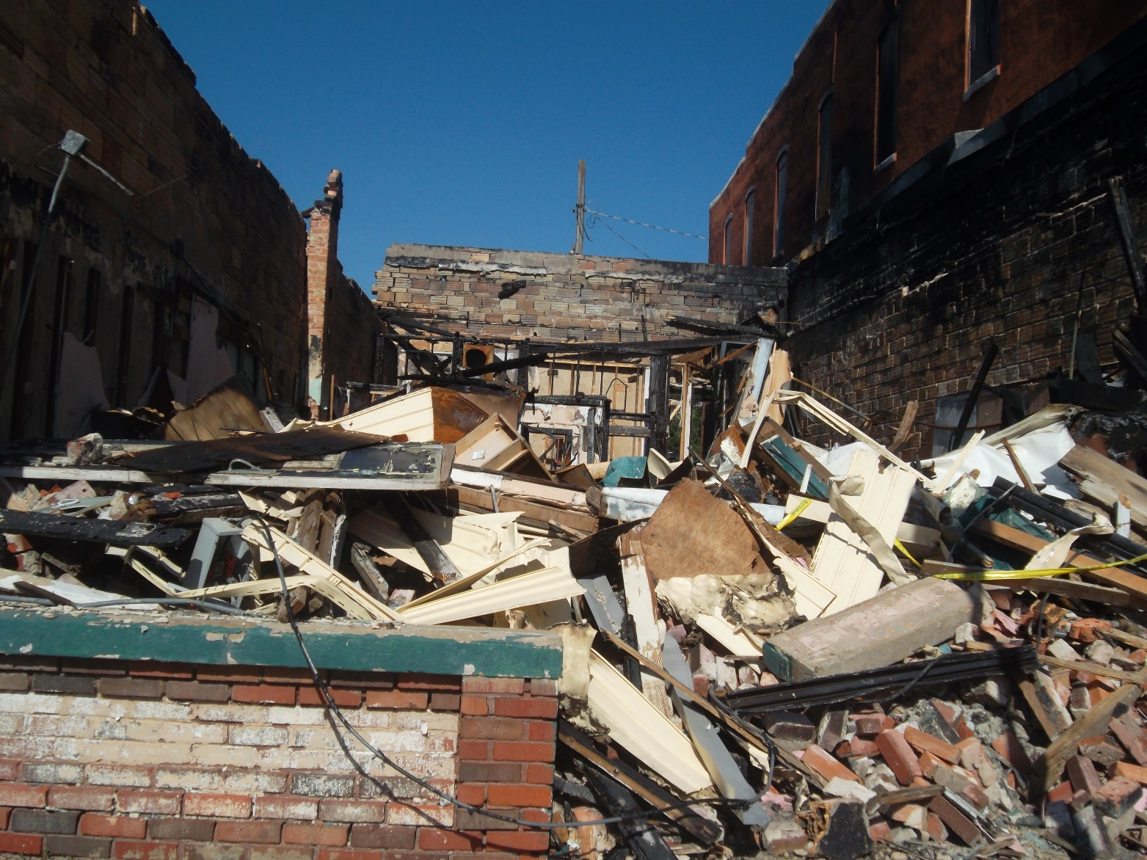
FRONT VIEW OF BUILDINGS

Slide 24
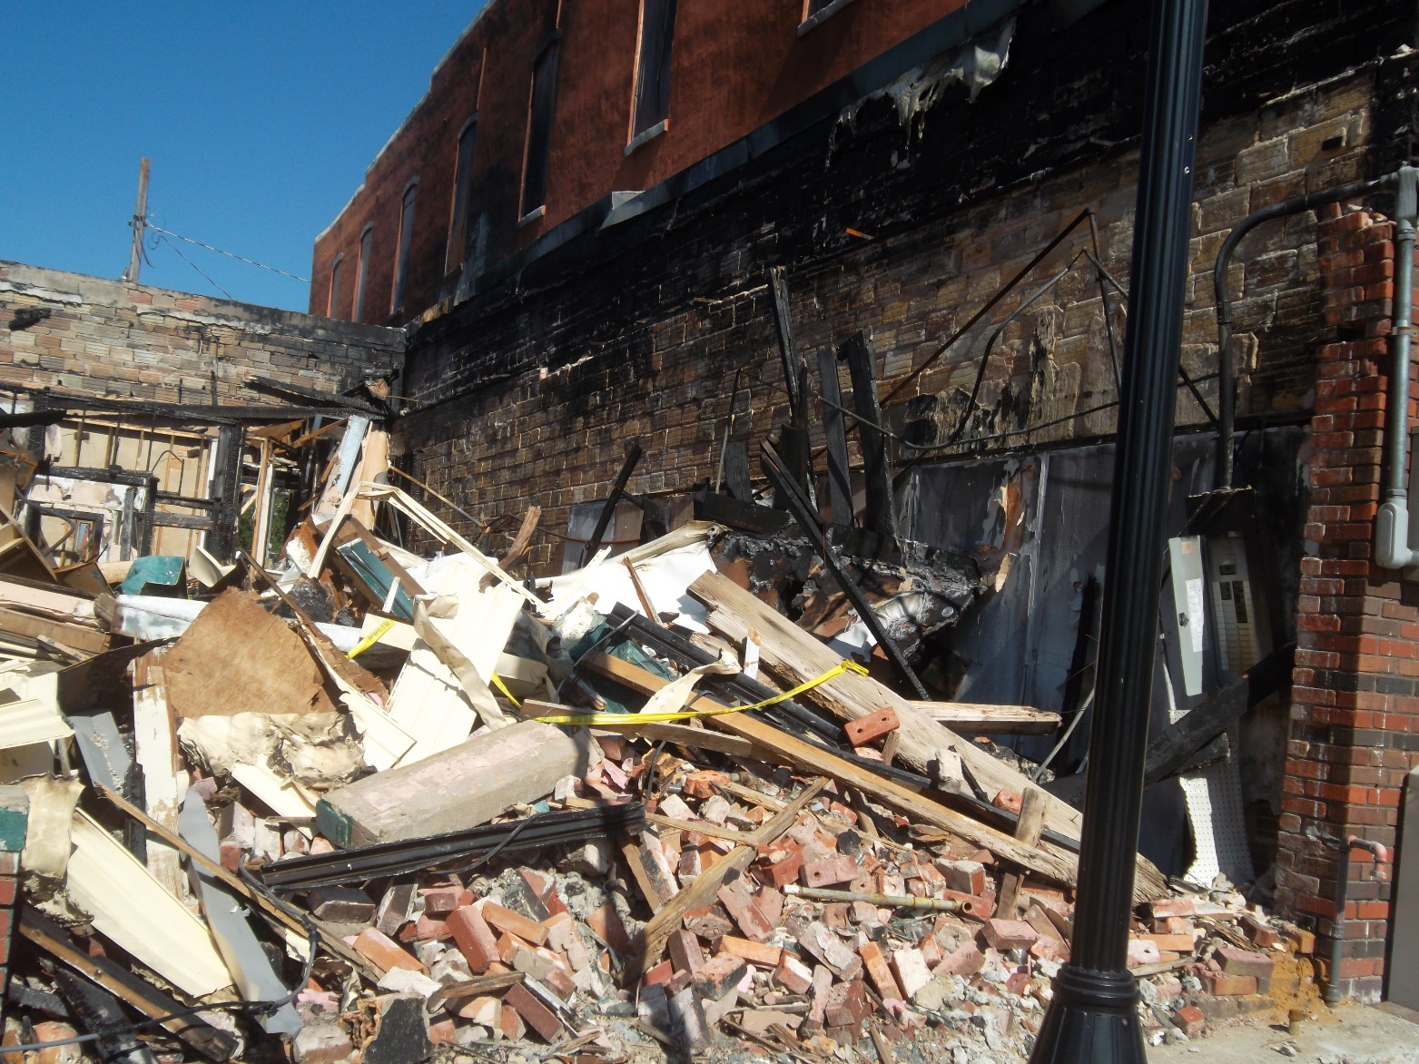
FRONT VIEW OF BUILDING

Slide 25
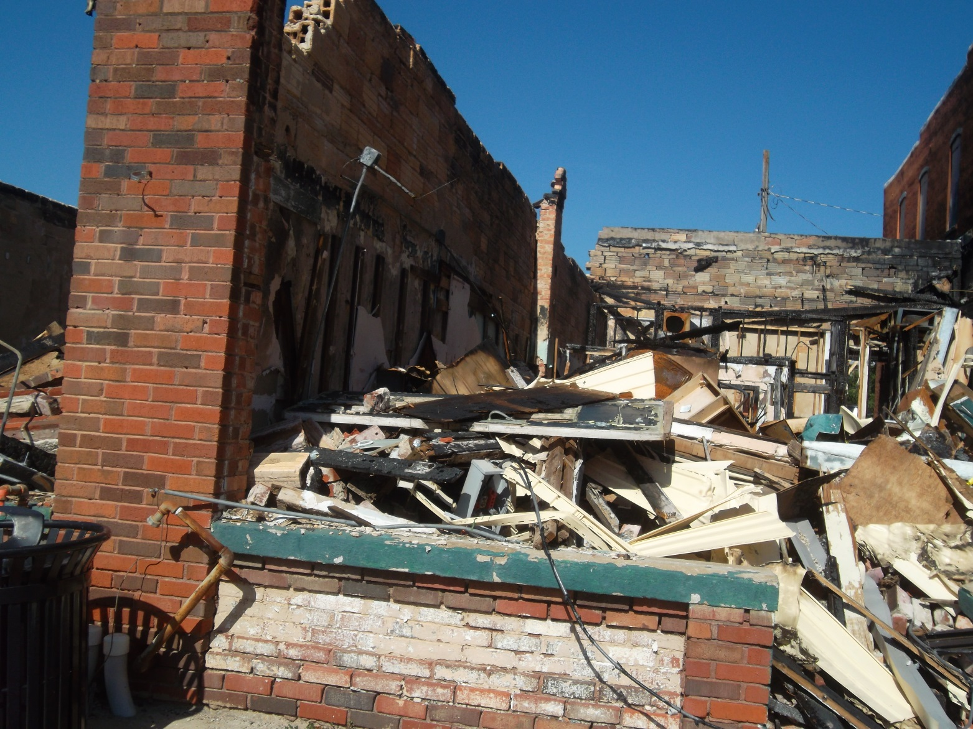
FRONT VIEW OF BUILDING

Slide 26
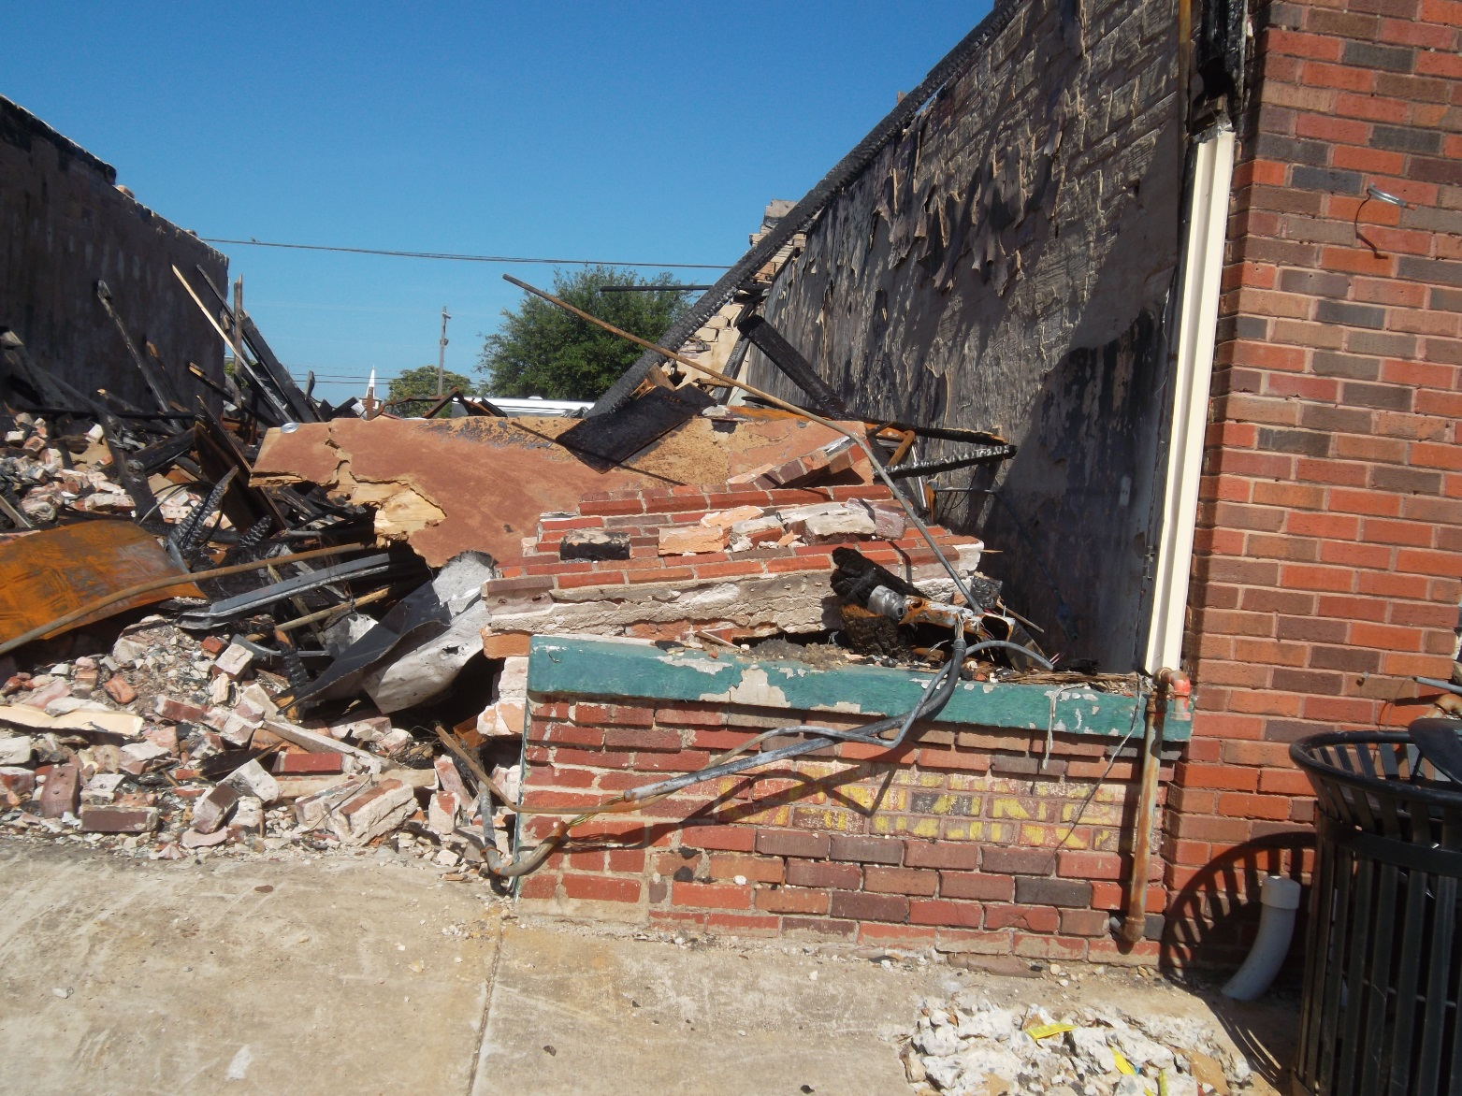
MY OPINION IS THIS BUILDING IS A DANGER TO ALL CITIZENS OF FARMERSVILLE—ESPECIALLY MINORS. IT PRESENTS A HEALTH AND SAFETY ISSUE AND NEEDS TO BE REMOVED IMMEDIATELY.

